Slide 1

Unit-V
Course In-Charges:
Dr.A.Mary Posonia
Dr.B.Ankayarkanni
SIT1305 Machine Learning

Slide 2
Self Organizing Maps
Kohonen’s maps
Self Organizing Maps or Kohonen’s map is a type of artificial neural networks introduced by Teuvo Kohonen in the 1980s.
SOM is trained using unsupervised learning
It uses competitive learning to adjust the weights
SIT1305 Machine Learning

Slide 3
Self Organizing Maps
SOM artificial neural network is used in dimensionality reduction
Helps to discover correlation between data
SIT1305 Machine Learning

Slide 4
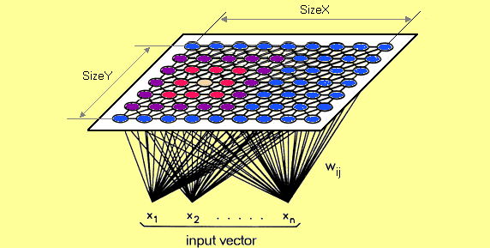
SOM’s architecture :
SOM has 2 layers
Input layer/ Output layer or feature map
SOM don’t have activation function in neuron
Directly pass the weight to the output layer
Each neuron in a SOM is assigned a weight vector with the same dimensionality d as the input space.
SIT1305 Machine Learning

Slide 5
Self organizing maps training
SOM doesn’t use back propagation for learning
Instead this type of unsupervised artificial neural network uses competetive learning to update its weights.
Competetive learning processes :
  Competetion
  Cooperation
  Adaptation
SIT1305 Machine Learning

Slide 6
SOM Process
1)Competetion :
Step1:Each neuron in a SOM is assigned a weight vector same dimension as input space
Step 2:Each neuron of the output layer we will have a vector with dimension n.
Step 3:Compute distance between each neuron and input data
Step 4:Neuron with the lowest distance will be the winner of the competetion.
SIT1305 Machine Learning

Slide 7
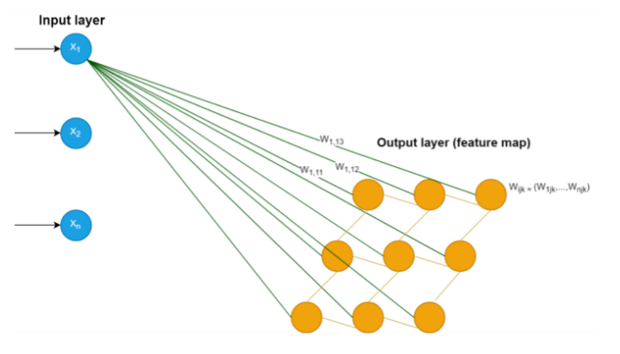
SOM Process
Euclidean metric is commonly used to measure distance.
SIT1305 Machine Learning

Slide 8
SOM Process
Coorporation:
update the vector of the winner neuron in the final process (adaptation)
it’s neighbor also will be updated.
To choose neighbors we use neighborhood kernel function
This function depends on two factor
Time
Distance
SIT1305 Machine Learning

Slide 9
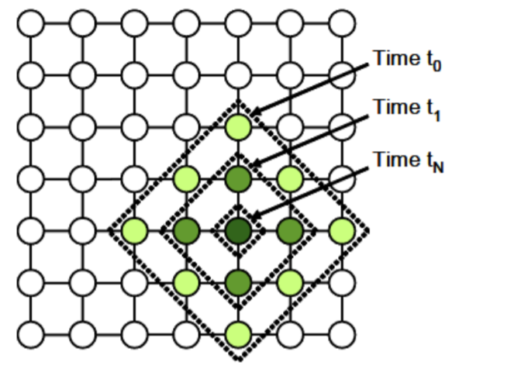
SOM Process: Neighbors Selection
Factors involved:
Time -time incremented each new input data
Distance-How far is the other neuron from the winner neuron).
SIT1305 Machine Learning

Slide 10
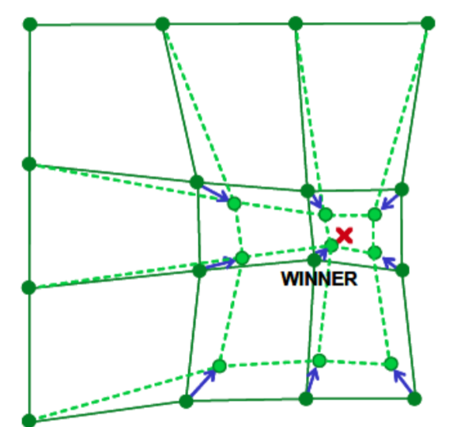
SOM Process
Adaptation:
After choosing the winner neuron and it’s neighbors we compute neurons update
Adjust the weight
SIT1305 Machine Learning

Slide 11
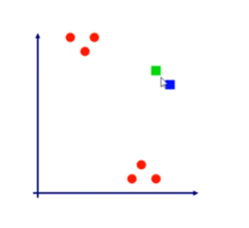

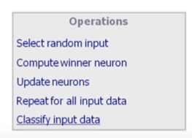
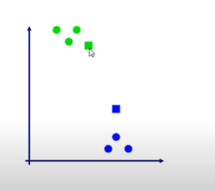
Process
SIT1305 Machine Learning

Slide 12
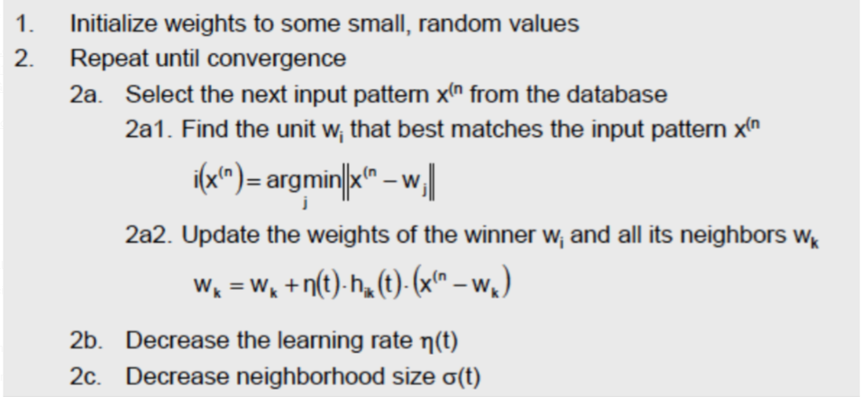
SOM Algorithm :
SIT1305 Machine Learning

Slide 13
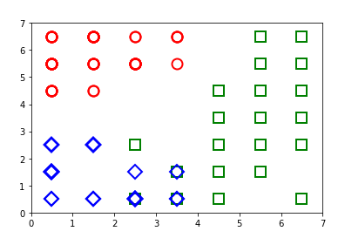
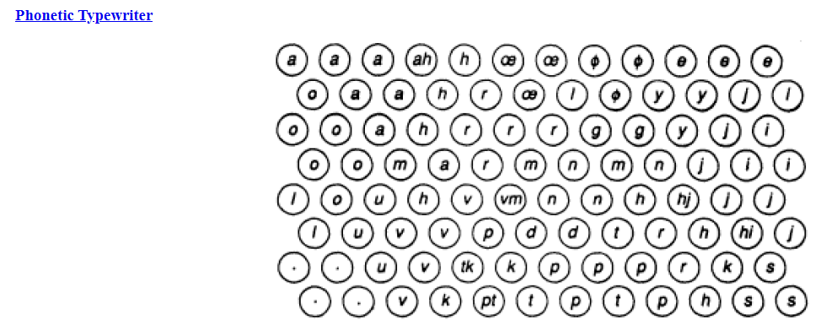
Coming to implementation part, there are various Python libraries (minisom, sompy) out there which you could directly use to implement SOM.
SIT1305 Machine Learning

